Slide 1
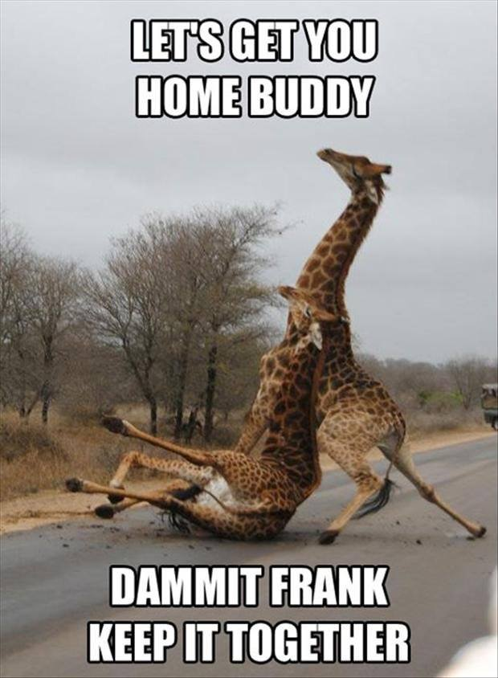
Timeline
Planning oral exams
Grammar: Past Simple and Present perfect
Work from the book
Notes:
Afbeelding: https://www.flickr.com/photos/studiodxavier/6063335422

Slide 2
Oral exams
Week | DV21 B
2 |  | Ashley Kimberly
3 |  | Indy
4 |  | Sanne Lars G.
5 | Test: Vocab + Grammar | Lars A. Lara Esmée
6 |  | Kevin Roos
7 |  | Wander Zoe Iris
8
9
10 | Test: Vocab + Grammar + Listening

Slide 3
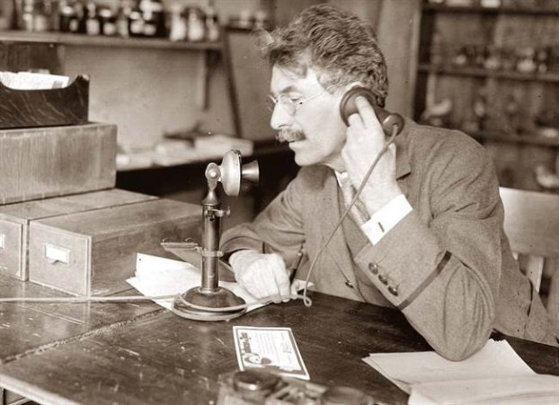
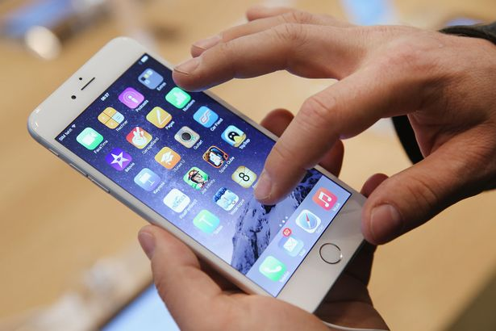
Past Tense
Past Present Future

Slide 4
Past Tense
Past = Verleden
Past Simple
Present Perfect
Je weet wanneer
Je weet niet wanneer
I worked
I have worked
Ik werkte
Ik heb gewerkt

Slide 5
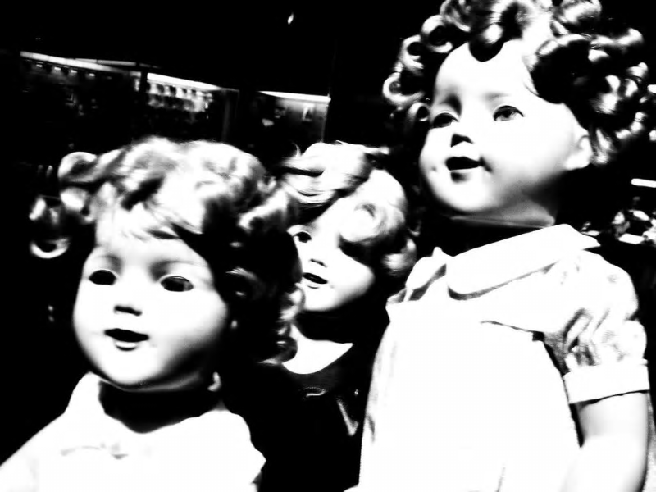
Past Simple
Assignment A
Listen to the story and underline the verbs in the past tense on your worksheet.
Make this assignment on your
own.
We will check the assignment
together.
Notes:
Verhaal komt van: https://www.buzzfeed.com/awesomer/boo-scared-you

Slide 6
Past Simple – Regular verbs
When
Duidelijk wanneer
Indicator
Yesterday
In 1983
Last week
Three days ago
A minute ago
When I was young
Rule
WW + ed
How
I worked
You worked
She/ He/ It worked
We worked
They worked

Slide 7
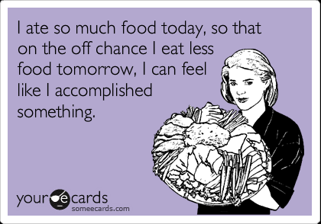
Past Simple – Irregular verbs
Irregular verbs
We also have them in the Dutch language
Regular rule doesn’t apply
Have to learn by heart
There are about 150 – only have to learn 30 (hand out)

Slide 8
Past Simple – Regular and Irregular verbs
Assignment B
Look at the list of irregular verbs
Read the story again and circle the irregular verbs in the past tense.
Assignment C
Make on your own
You have 3 minutes
Assignment D + E
Homework = check next week
Notes:
De foto is de link naar de clip. Deze tekst staat in het begin van het nummer.

Slide 9
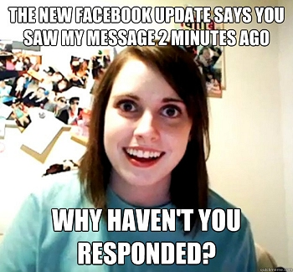
Present Perfect – Example
Past Simple
Present Perfect

Slide 10
Present Perfect – Example
Past Simple
Present Perfect

Slide 11
Present Perfect – Example
Past Simple
Present Perfect

Slide 12
 | Past Simple Ik werkte | Present Perfect Ik heb gewerkt
When | Duidelijk wanneer het gebeurd is | Onduidelijk wanneer het gebeurd is
Rule | ww + ed | Have/ has + ww + ed
Uitzonderingen op de regel | Irregular verbs (onregelmatige ww.) zijn allemaal verschillend en moet je uit je hoofd leren. Krijg je op stencil.
How I | worked | have worked
You | worked | have worked
She / He / It | worked | has worked
We | worked | have worked
They | worked | have worked
Indicator | - Yesterday | - For
 | - In 1983 | - Yet
 | - Last week | - Never
 | - Three days ago | - Ever
 | - A minute ago | - Just
 | - When I was young | - Already
 |  | - Since
 |  | - Once
 |  | - Recently

Slide 13
Past Simple – Regular and Irregular verbs
Assignment F
Make on your own
You have 3 minutes
Look at the list of irregular verbs
Assignment G
Homework = check next week
Additional practice on Present Perfect
https://www.englisch-hilfen.de/en/exercises/tenses/present_perfect_statements.htm
More difficult because regular and irregular verbs: https://www.perfect-english-grammar.com/present-perfect-exercise-1.html
Notes:
De foto is de link naar de clip. Deze tekst staat in het begin van het nummer.

Slide 14
Self study

